Slide 1
WDZ
INTRODUCTION TO MANAGEMENT AND ORGANIZATION

Slide 2
Mateusz Kowalik, MA
mateuszk@pjwstk.edu.pl

Slide 3
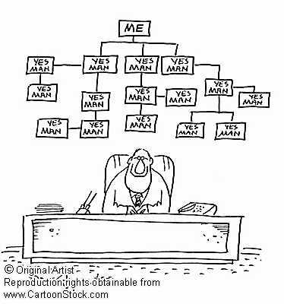
Basics of management

Slide 4

Management – Science or Art?

Slide 5
Link to poll https://forms.gle/K8P8PvyLCaG7HQFj9

Slide 6
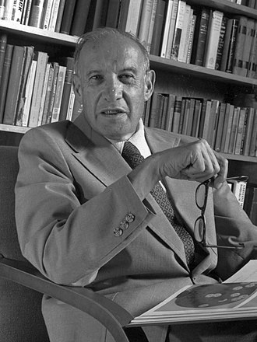
Peter F. Drucker on MANAGEMENT
Peter F. Drucker
(1909 – 2005)
It is concerned mainly with ……….
It is deeply rooted in ………..
It needs simple, clear objectives and values, shared by all employees (MBO)
It needs …………… (inside and outside the organization)
It needs an extensive monitoring system of indicators to evaluate and improve efficiency
It must be ………-oriented (…….. satisfaction = the main goal)

Slide 7
Peter F. Drucker on MANAGEMENT
Peter F. Drucker
(1909 – 2005)
It is concerned mainly with PEOPLE
It is deeply rooted in culture
It needs simple, clear objectives and values, shared by all employees (MBO)
It needs communication (inside and outside the organization)
It needs an extensive monitoring system of indicators to evaluate and improve efficiency
It must be customer-oriented (customer satisfaction = the main goal)

Slide 8
Ricky W. Griffin
A set of activities (including planning and decision making, organizing, leading and controlling) directed at an organization's resources (human, financial, physical and information) with the aim of achieving organizational goals in an efficient and effective manner.

Slide 9
Ricky W. Griffin
A set of activities (including planning and decision making, organizing, leading and controlling) directed at an organization's resources (human, financial, physical and information) with the aim of achieving organizational goals in an efficient and effective manner.

Slide 10
Management - definitions
Management = the achievement of objectives through people and other resources.
Management = the process of setting and achieving goals through the execution of the four basic functions of management utilizing human, financial and material resources.

Slide 11
Management - definitions
Four Functions of Management:
Planning
Organizing
Directing/Leading
Controlling

Slide 12
…but before we can start with the 4 functions of management we need a clear….
GOAL
Preferably a SMART GOAL

Slide 13
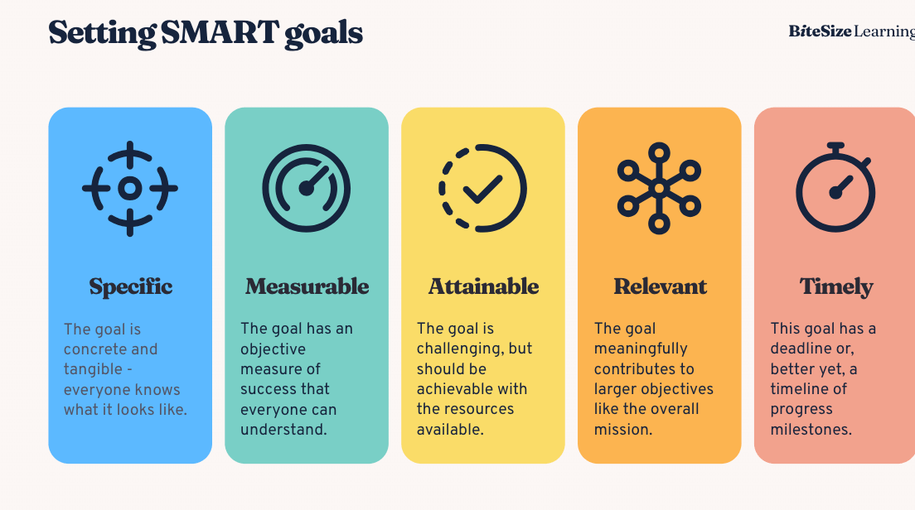

Slide 14
Four Functions of Management:
Planning – setting up a global goal and specific goals
Organizing – determining who should do (and what) to let the organization achieve its goals
Directing – leading and motivating organization members to cooperate
Controlling – defining performance evaluation measures + ongoing measurement of evaluation measures + taking possible corrective actions

Slide 15
PLANNING
Definition: Setting objectives and determining the steps required to achieve them.
In a Game Dev Company:
Game Conceptualization: Managers explore and identify potential concepts, genres, and visions that could appeal to target audiences and fill market gaps.
Resource Allocation: Deciding on the allocation of various resources such as team assignments, technology, and budget to various aspects of game development.
Risk Management: Anticipating potential challenges related to technology, market dynamics, or team management, and formulating strategies to mitigate them.

Slide 16
ORGANIZING
Definition: Structuring work, arranging resources, and ensuring coordination to attain organizational goals.
In a Game Dev Company:
Team Structuring: Forming teams based on the specific skill sets needed for the project, including design, development, writing, and testing.
Task Delegation: Assigning specific tasks and responsibilities to individuals or teams based on their specializations.
Coordination: Ensuring synchronicity between different departments, such as making sure that the development and story-writing teams are aligned in their efforts.

Slide 17

LEADING / DIRECTING
Definition: Motivating and leading team members towards achieving the set objectives.
In a Game Dev Company:
Vision Communication: Ensuring that each member understands and aligns with the vision and goals for the game being developed.
Team Morale and Motivation: Maintaining a positive and encouraging environment, ensuring work-life balance, and managing work-related stresses, especially during crunch times.
Feedback and Collaboration: Creating an environment that encourages the sharing of feedback and ideas, and fosters collaborative innovation throughout the development process.

Slide 18
CONTROLING
Definition: Monitoring and evaluating activities to ensure that the company is progressing towards its goals.
In a Game Dev Company:
Quality Assurance (QA): Implementing thorough testing phases to detect and rectify bugs, ensuring the final product aligns with desired quality standards.
Performance Metrics: Monitoring the development process against set timelines and milestones, ensuring the project is on track.
Feedback Integration: Employing feedback from test phases or initial releases to refine and optimize the game, ensuring it meets user expectations upon full release.

Slide 19
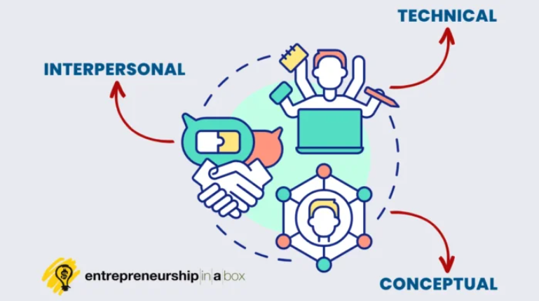
Manager - 3 fundamental skills:
Technical possess specific knowledge or have a specialized expertise
Human be able to work well with others both individually and in a group setting
Conceptual be able to see the „big picture” of the situation. Ability to arrive at ideas, create a vision and plan for the future

Slide 20
Managers
First-line managers - manage the work of non-managerial individuals or also known as operative employees, who are directly involved with the production or creation of the organization’s products.
Middle-level managers - all managers between the first-line level and top level of the organization e.g. department head.
Top-level managers – responsible for making decisions about the direction of the organization and establishing the plans and goals that affect the entire organization.

Slide 21

Manager - 3 fundamental skills TECHNICAL
Game Dev Company - Technical Skills Examples
Software & Tools Proficiency: Knowing how to use game development software (like Unity or Unreal Engine) and understanding programming languages (such as C# or C++).
Development Process Knowledge: Understanding the entire game development pipeline, from concept to release, including game design, programming, art creation, testing, and deployment.
Cybersecurity: Ensuring the integrity and security of development tools, proprietary game data, and user information.
Application to Technical Human Resources:
Ensuring all team members are trained and proficient in necessary technologies.
Recognizing and addressing tech-related challenges in the development process.
Managing technology resources and ensuring that teams have access to the tools they need.

Slide 22

Manager - 3 fundamental skills CONCEPTUAL
Game Dev Company – CONCEPTUAL Skills Examples
Strategic Planning: Identifying market trends and aligning game development projects accordingly.
Innovation Management: Facilitating an environment where new ideas are encouraged and explored.
Quality Assurance: Ensuring that the end product aligns with the company’s standards and vision.
Application to Technical Human Resources:
Developing strategies to align talent management with the overall strategic goals of the company.
Ensuring that teams are structured in a way that supports innovation and strategic objectives.
Creating pathways for technical professionals to contribute to strategic planning and decision-making.

Slide 23
Managerial skills
Conceptual
skills
Human
skills
Technical
skills
Top-level managers
Middle-level managers
First-line managers
Technical
Level of importance

Slide 24
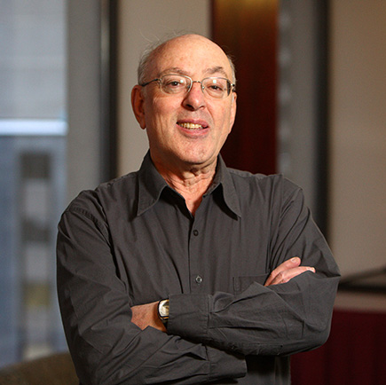
Managerial roles
One of the most important pieces of research into the job of manager comes from Henry Mintzberg
Mintzberg followed a range of senior managers and observed their activities
Based on data he collected, he distinguished and described 10 different management roles that he grouped under three headings: intepersonal, informational and decisional

Slide 25

Henry Mintzbergs 10 Managerial Roles CD PROJEKT

Slide 26
CD PROJECT – INTERPERSONAL ROLES EXAMPLES
Figurehead:
Leading press conferences or presenting at industry events, such as when announcing a new title or providing updates on "Cyberpunk 2077."
Facilitating milestone celebrations, such as the successful launch of "The Witcher 3: Wild Hunt."

Slide 27

Manager - 3 fundamental skills HUMAN
Game Dev Company – HUMAN Skills Examples
Team Coordination: Ensuring various units (programming, design, art, testing) work harmoniously.
Conflict Resolution: Mediating disputes and facilitating a healthy working environment.
Motivation: Inspiring teams to stay creative and productive through challenging development cycles.
Application to Technical Human Resources:
Sourcing, hiring, and retaining top talent within various technical domains of game development.
Ensuring that the work environment supports creativity and well-being.
Managing workforce dynamics effectively to maintain a positive and inclusive culture.

Slide 28
Managerial roles
Category | Role | Activity
Interpersonal | Figurehead | Perform ceremonial and symbolic duties inside the organization, receive visitors. Give awards to employees.
 | Leader | Supervise direct subordinates, including recruting, selecting, motivating, training and leading them.
 | Liaison | Be the conduit (the in-between person) for information flowing in and out of organization.
Informational | Monitor | Look for and receive information, review papers and reports, maintain interpersonal contacts and networks.
 | Disseminator | Pass information on to others by phone, in meetings, memos.
 | Spokesperson | Represent the area or organization to people outside the area or organization in spechees and reports. Deal with the media.
Decisional | Entrepreneur | Initiate change. Plan new projects, spot opportunities, identify areas of business development.
 | Disturbance handler | Take corrective action during crises or operational breakdowns, resolve conflicts amongst staff, adopt to external changes.
 | Resource allocator | Decide who gets resources, sets the schedule, budget, set priorities.
 | Negotiator | Represent department during negotiations with unions, suppliers.

Slide 29
Managerial roles
Category | Role | Activity
Interpersonal | Figurehead
 | Leader
 | Liaison
Informational | Monitor
 | Disseminator
 | Spokesperson
Decisional | Entrepreneur
 | Disturbance handler
 | Resource allocator
 | Negotiator

Slide 30
CD PROJECT – INTERPERSONAL ROLES EXAMPLES
Leader:
Nurturing the renowned meticulous and artistic development culture that enabled the creation of critically acclaimed titles.
Managing and supporting teams during the extended development and post-launch phases of "Cyberpunk 2077."

Slide 31
CD PROJECT – INTERPERSONAL ROLES EXAMPLES
Liaison:
Forming alliances or partnerships with platforms like Steam or GOG to distribute games.
Collaborating with external entities, like Sapkowski (author of The Witcher books) or other media companies for series adaptations.

Slide 32
CD PROJECT – INFORMATIONAL ROLES EXAMPLES
Monitor:
Keeping abreast with player feedback and community sentiments, especially amidst the controversies and technical issues following "Cyberpunk 2077" release.
Analyzing industry trends and competitor products to inform future game development strategies.

Slide 33
CD PROJECT – INFORMATIONAL ROLES EXAMPLES
Disseminator:
Communicating updates or patches, like disseminating information regarding updates or improvements for "Cyberpunk 2077" to all relevant development and customer service teams.
Ensuring the company-wide understanding of strategic goals and project timelines.

Slide 34
CD PROJECT – INFORMATIONAL ROLES EXAMPLES
Spokesperson:
Publicizing collaborations, expansions, or project updates, such as during the development and post-launch stages of "The Witcher" series.
Addressing public and media queries about the company's directions, strategies, and responses to issues like the "Cyberpunk 2077" launch difficulties.

Slide 35
CD PROJECT – DECISIONAL ROLES EXAMPLES
Entrepreneur:
Initiating new projects or spin-offs based on the success of existing franchises, like expanding "The Witcher" universe.
Driving technological and creative innovations to maintain the high-quality storytelling and immersive world-building the company is known for.

Slide 36
CD PROJECT – DECISIONAL ROLES EXAMPLES
Disturbance Handler:
Managing crisis situations, such as addressing the technical issues and public relations challenges following the launch of "Cyberpunk 2077."
Implementing solutions to mitigate internal and external disruptions, ensuring the stability of ongoing projects.

Slide 37
CD PROJECT – DECISIONAL ROLES EXAMPLES
Resource Allocator:
Balancing resources among various ongoing developments, marketing, and customer support especially during multi-project periods involving titles like "Cyberpunk 2077" and "The Witcher."
Deciding on budget allocations for various departments to ensure efficient operations and high-quality game development.

Slide 38
CD PROJECT – DECISIONAL ROLES EXAMPLES
Negotiator:
Negotiating with platform providers and distributors for favorable terms during game launches or for exclusive deals.
Engaging in discussions and agreements with external entities, such as licensing agreements for "The Witcher" series adaptations.

Slide 39
Tips for improvement
Figurehead: If you struggle wearing this hat, start with cultivating humility and empathy. Focus on using your energy to be a good role model and become more aware of your image and reputation and how you can consistently display model behawior.
Leader: Anyone can be a leader, but not everyone can be an authentic leader who is respected by his or her team. The most important skill here to develop to improve is emotional intelligence.
Liaison: Not everyone is comfortable being a part of a network, but it’s part of the job. You can start by attending small networking events and work your way out.

Slide 40
Tips for improvement
Monitor: The challenge of this aspect lies in its details. Become a better “skimmer” so you can scan through a lot of information and get to the big picture without experiencing information overload.
Disseminator: If you struggle in this area, work on improving your communication skills. Knowing not only what to share, but how and with whom. If you have difficulty expressing things properly, engage a colleague to help in the beginning with proofreading or being a second pair of eyes as you adjust in this role.
Spokesperson: This is an area where a lot of people feel challenged. Read blogs and research how to deliver great presentations and how to deal with the media. Speak with your company leaders to discuss how the company’s brand or image should be represented in the community.

Slide 41
Tips for improvement
Entrepreneur: Work on problem solving and creativity skills or again, if this is not your strength, employ colleagues who excel here with brainstorming sessions or “crazy ideas” meetings.
Disturbance Handler: You can read up on how to handle team conflict to improve your conflict resolution skills, but it may also be helpful to constructively coach team members who have a habit of bringing emotion into the office.
Resource Allocator: To wear this hat, prioritization is key. Take advantage of online tools and systems for this as well as budgeting tips.
Negotiator: Read about Win-Win Negotiations to beef up your skills. Role playing can also be an important tool here to strengthen your ability to negotiate.

Slide 42

„Soft” skills or „hard” skills?
I. Hard management:
Strategies
Structures
Systems

Slide 43

„Soft” skills or „hard” skills?
II. Soft management:
Skills
Human resources
Management styles

Slide 44
Soft management
Ethics
Culture
Cultism

Slide 45

Soft management
Ethics in management:
The attitude of the organization to the employee
The attitude of the employee to the organization
The attitude of the organization to customers and business partners

Slide 46

Soft management
One of the problems - mobbing:
= emotional abuse in the workplace
= systematic psychological abuse or humiliation of a person by an individual or a group, with the aim of damaging his/her reputation, honor, human dignity and integrity, and ultimately driving the victim to quit the job.
Source: www.jehnstar.com

Slide 47

The role of the manager – two theories
1. Omnipotent view of management:
managers are responsible for the organization’s success or failure
the quality of the organization’s managers determines the quality of the organization itself
bad times – „someone” is to blame
„someone” = the manager ☹

Slide 48
The role of the manager – two theories
2. Symbolic view of management:
much of the organization’s success or failure is due to external sources outside managers’ control
the manager’s role – minimal

Slide 49
The role of the manager – two theories
Reality: managers are neither helpless nor all powerful
But: within every organization there exist internal and external constraints
Environment
Organizational culture

Slide 50
External environment
External environment: those factors and forces outside the organization that affect the organization’s performance.

Slide 51
External environment / Internal Environment

Slide 52
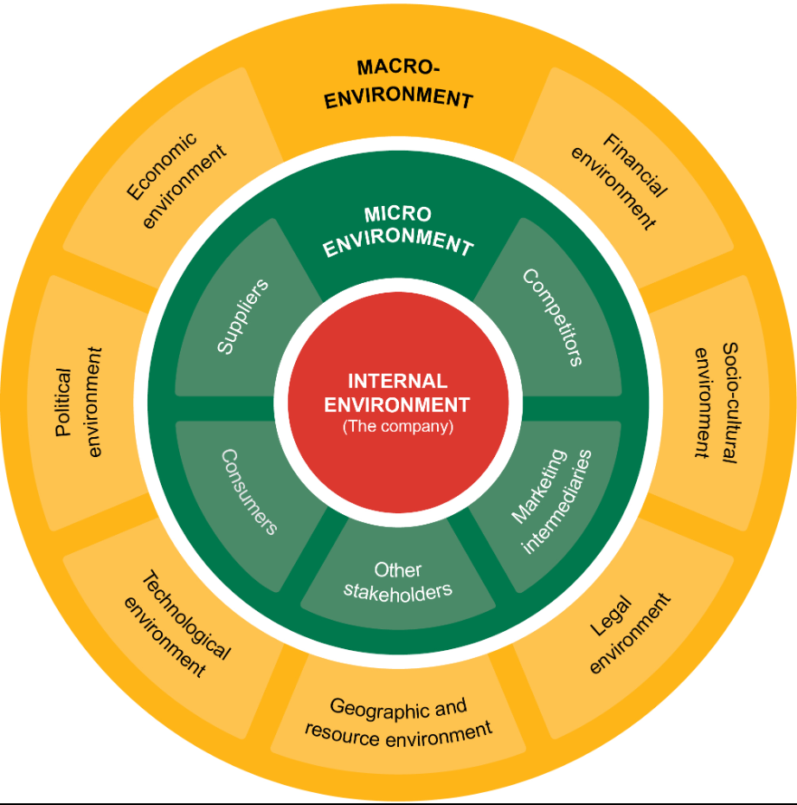

Slide 53
External environment
The General Environment = broad external conditions that may affect the organization:
Economic conditions
Political/legal constraints
Sociocultural conditions
Demographic conditions
Technological
Global

Slide 54
External environment
The Task Environment = those industry factors which are external to the firm but have a direct and specific impact upon the organization
Competitors
Customers
Suppliers
Government regulators
Pressure groups
Labor unions

Slide 55

External Business Environment
CD PROJEKT

Slide 56
CUSTOMERS CD Projekt: Micro-Environment
Customers:
Gamers: Understanding their preferences, expectations, and satisfaction levels with CD Projekt games.
Other Buyers: Physical and online retailers who stock and sell CD Projekt games.

Slide 57
SUPPLIERS CD Projekt: Micro-Environment
Suppliers:
Technology Providers: Suppliers of game development tools, software, and hardware.
Merchandise Vendors: Entities producing physical goods and merchandise related to CD Projekt titles.

Slide 58
COMPETITORS CD Projekt: Micro-Environment
Competitors:
Direct Competitors: Other major video game developers and publishers, like Ubisoft or Electronic Arts.
Indirect Competitors: Other forms of entertainment, such as movies, that compete for the same discretionary spending.

Slide 59
INTERMEDIARIES CD Projekt: Micro-Environment
Intermediaries:
Distributors: Platforms like Steam, GOG, or physical retailers that facilitate the sale of CD Projekt games to customers.
Marketing Agencies: Firms that assist in promoting and marketing CD Projekt titles globally.

Slide 60
PUBLICS CD Projekt: Micro-Environment
Publics:
Media: Gaming journalists and general media that cover news and reviews about the company and its products.
Financial Publics: Investors, shareholders, and analysts who monitor the financial performance of CD Projekt.

Slide 61
ECONOMIC FORCES CD Projekt: Macro-Environment
Economic Forces:
Global Economic Trends: Economic health influencing consumer spending on entertainment and technology.
Currency Exchange Rates: Affecting the global pricing and profitability of CD Projekt’s offerings.

Slide 62
TECHNOLOGICAL FORCES CD Projekt: Macro-Environment
Technological Forces:
Emerging Technologies: New advancements that can be utilized in game development.
Cybersecurity: Technologies and practices that protect company data and user information.

Slide 63
POLITICAL & LEGAL FORCES CD Projekt: Macro-Environment
Political and Legal Forces:
Intellectual Property Laws: Governing the use and protection of creative assets and proprietary technology.
Trade Policies: Regulations and policies affecting international trade and digital sales.

Slide 64
SOCIOCULTURAL FORCES CD Projekt: Macro-Environment
Sociocultural Forces:
Cultural Trends: Impacting game themes, character development, and narrative choices.
Social Movements: Such as those advocating for greater inclusivity and diversity in gaming.

Slide 65
DEMOGRAPHIC FORCES CD Projekt: Macro-Environment
Demographic Forces:
Age Demographics: Understanding the age distribution of the gamer population and tailoring products accordingly.
Global Population Trends: Recognizing global demographics to cater to varied international markets.

Slide 66
NATURAL & ENVIRONMENTAL FORCES CD Projekt: Macro-Environment
Natural and Environmental Forces:
Sustainability: The push towards more environmentally friendly business practices.
Climate Change: A factor that could impact various operational and strategic aspects of the business.

Slide 67
NATURAL & ENVIRONMENTAL FORCES CD Projekt: Macro-Environment
Natural and Environmental Forces:
Sustainability: The push towards more environmentally friendly business practices.
Climate Change: A factor that could impact various operational and strategic aspects of the business.

Slide 68
GLOBAL FORCES CD Projekt: Macro-Environment
Natural and Environmental Forces:
Geopolitical Issues: Political stability and international relations that may impact global operations.
Global Market Dynamics: Navigating diverse international markets with varied cultural and regulatory landscapes.

Slide 69
External environment
The Manager’s role:
to assess environmental uncertainty (= the degree of change and complexity)
to manage stakeholder relationships
Stakeholders = any constituencies in the organization’s environment that are affected by the organization’s decisions and actions.

Slide 70
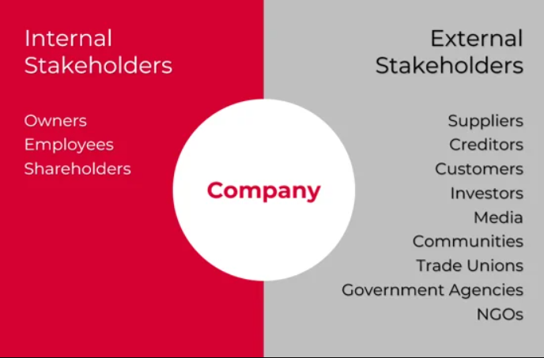
INTERNAL / EXTERNAL STAKEHOLDERS

